Slide 1
Submitted by :
Name : Mst. Fareya Azam
Roll no :1331
SPL-1 Presentation
CONTROL FLOW ANALYSIS
Supervised by:
Dr.Md.Sumon Ahmed
Professor
Institute of Information Technology,DU

Slide 2
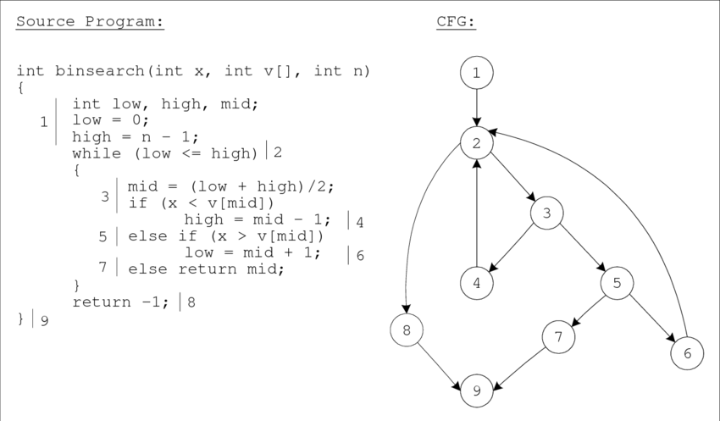
Introduction to my project
Source code
Control flow
graph

Slide 3
Control flow analysis is a technique through which we determine the control flow of a program.It is a graphical representation of program .
My project is about generating a Control Flow Graph of a program. The project aims to develop a program that will take a source code file in C as input and generate its Control Flow Graph as output .It will show all the paths that can be traversed during program execution.

Slide 4

Why Control flow analysis??
It helps us to understand the flow of function calling during execution ; with the help of Control Flow Graph.

Slide 5
Background study :
1. Lexical Analysis:
it helps to tokenization.
Types of statements:
Statements are the executable parts of the program that will do some actions . Types of statements that we need are :

Slide 6
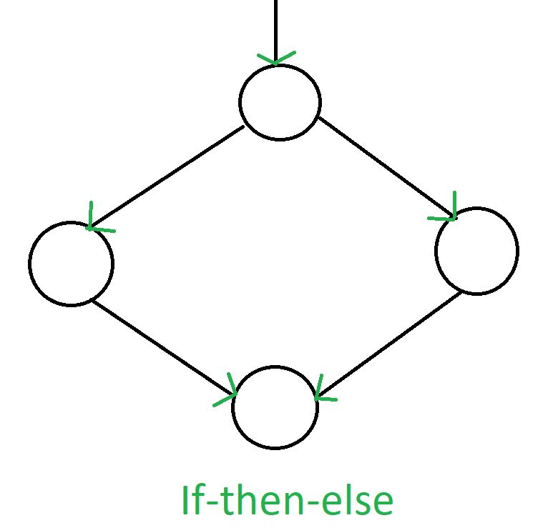
a. Selection statement: 1.if 2.else if 3.else 4.Switch

Slide 7
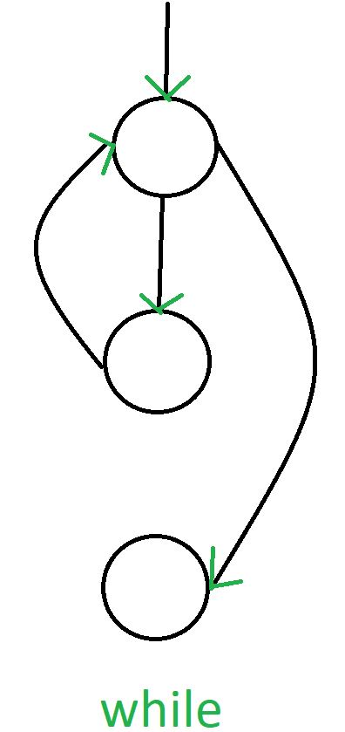
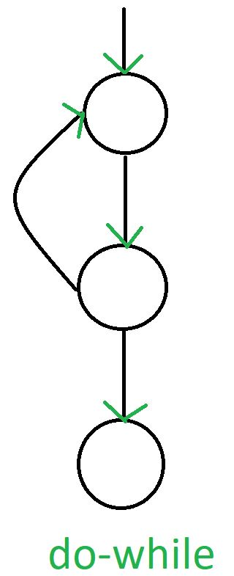
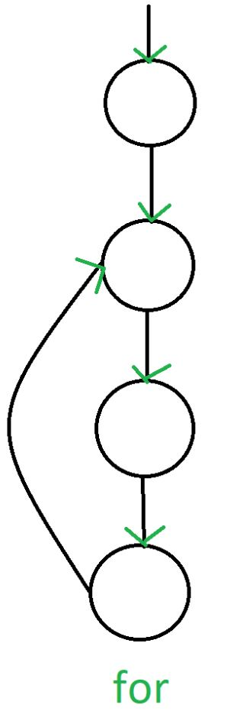
b. Iterative statement: Loops

Slide 8
C . Jump Statements break, goto,continue.
Procedure:
At first the program will take a source code file in c . Then it will read the file line by line and tokenize it .
Later using the tokens of statements I will make nodes using structure . This nodes will provide token type , line number in which it is occurred, parent node and child node .

Slide 9
In this project, we considered the program only contains Expression, Selection and Iterative Statements. After making nodes we will make relations between the edges .
Then we will push the nodes into an arraylist.
After that we will use dfs to create the Adjacency List and Adjacency Matrix.
Then in output it will show the CFG through Adjacency list and matrix

Slide 10
My progress:
I have read a c source code file char by char and generated all the tokens as output.
Further work I have to do is to keep track of line with the tokens, create nodes and edges of the required tokens as mentioned above ,generate the Control Flow Graph.

Slide 11
Challenges
The source code file can have comments and unnecessary white spaces.
After reading character by character ,converting them into a substring was very challenging.
Creating edges among tokens will not be easy enough

Slide 12
Conclusion
This project from the problem solving point of view is very interesting to me.Though now it can handle simple program, I think by adding more features it will be more helpful and optimized.

Slide 13


